Slide 1


TELEHEALTH
Bringing care to you, anywhere
Anusree Preetha Ranjith(s0585834) Hiten Kulkarni(s0586098)
Sharanya Adiga(s0585849)

Slide 2

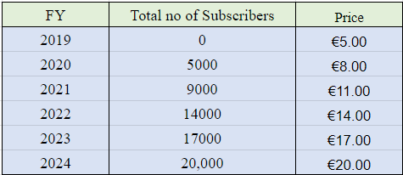
INTRODUCTION
Telehealth is a platform where one can access health care services remotely.
Project focuses to provide an overview of cost analysis on the whole team of the product.
Product Pricing:

Slide 3








PRODUCT ANALYSIS
Ease of use.
24/7 Availability.
HealthGPT.
Multilingual support.
Lab tests and Medicines delivery.
Appointment scheduling and reminders.
Secured messaging and file sharing.
Integrate with wearable devices such as smart watches, fitness trackers.

Slide 4

GOALS AND OBJECTIVES
Goal 1: Enhance Healthcare Accessibility
Objectives:
Ensure seamless access to online consultations with doctors for users in urban and rural areas.
Enable the delivery of lab tests and self-help kits to users' doorsteps.
Partner with pharmacies for timely and secure medicine deliveries.
Goal 2: Increase Revenue
Objectives:
Increase sales by 15% in the next fiscal year through targeted marketing campaigns.
Introduce two new product lines to capture untapped market segments.
Goal 3: Enhance Customer Satisfaction
Objectives:
Achieve a customer satisfaction rating of 90% or above in customer surveys.
Implement a customer feedback system to gather insights for continuous improvement.
Goal 4: Expand Market Presence
Objectives:
Enter two new geographical markets within the next 12 months.
Develop partnerships with three key influencers to increase brand visibility.
Increase online presence through social media advertising and SEO strategies.

Slide 5

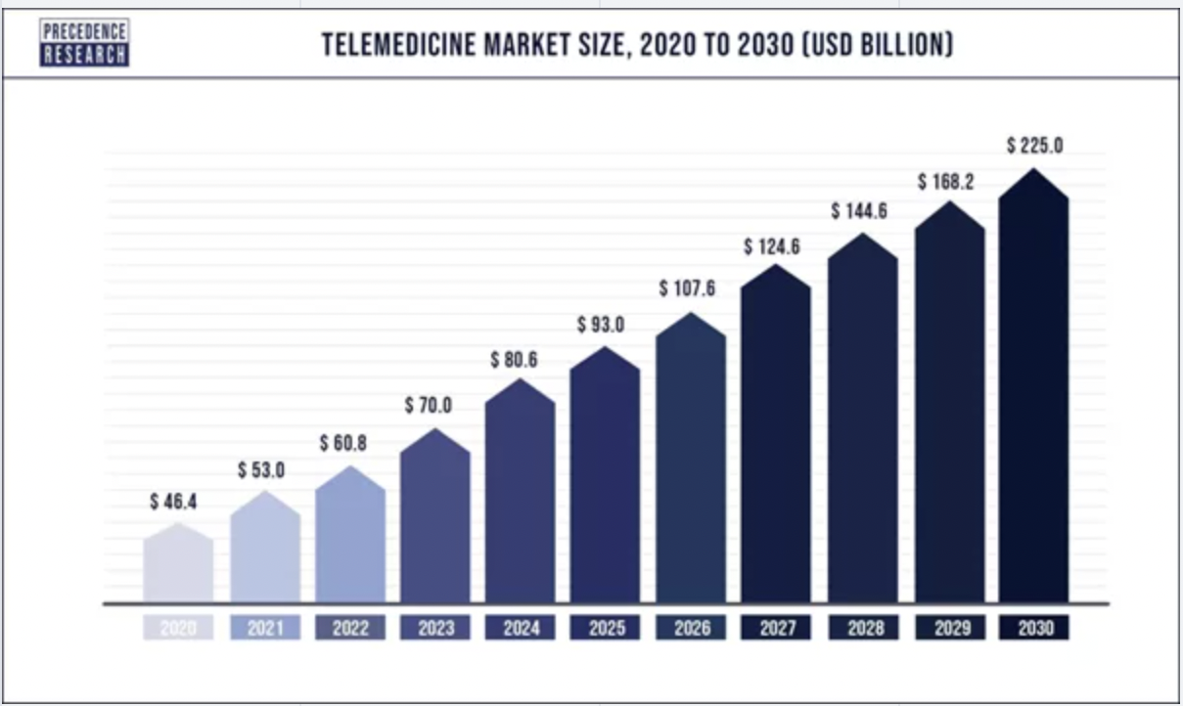
MARKET ANALYSIS
Telemedicine market is expected to gain market growth in the forecast period of 2022 to 2029.
Europe market is growing with a CAGR of 8.8% in the forecast period of 2022 to 2029 and is expected to reach USD 6,309.21 million by 2029 from USD 3,244.14 million in 2021.
https://www.databridgemarketresearch.com/reports/europe-telehealth-market

Slide 6
CLOUD vs HYBRID
Promoting remote patient care and improving accessibility to healthcare services
Can easily scale up or down based on demand.
Offers encryption, data backups, and regular security updates to protect patient records
Has a pay-as-you-go model, reducing upfront infrastructure costs
Healthcare organization hosts and manages all the necessary hardware and software within their own facilities
Scaling on-premise solutions can be costly and time-consuming
Faces more challenges in terms of technical implementation, resource allocation, and staying abreast of evolving regulations
Organizations need to invest in servers data centers, and maintenance, which can strain budgets

Slide 7
Promoting remote patient care and improving accessibility to healthcare services
RISKS | MITIGATION
A security breach exposes patient records leading to legal actions, loss of trust from both patients and healthcare providers. | Use end-to-end encryption for all communications and schedule quarterly security assessments.
System outages due to software glitches can lead to customer dissatisfaction, patient loss, and increased IT expenses to resolve issues promptly | Use automated testing tools , engaging IT experts and having backup servers to solve the issue
After the end of pandemic, people may go back to offline hospitals rather than finding online alternatives | Spreading awareness amongst people, providing insurance coverage and also providing high-quality care standards in telehealth consultations

Slide 8
 |  | SOFTWARE COST
PLANNING
PEOPLE COST
HARDWARE COST
Jira | €672.00
VS Code | €0.00
MongoDB | €640.00
Github | €0.00
Office 365 | €60.00
AWS | €2,490.00
Domain Cost | €15.00
Misc | €400.00
Developers (Senior) | €204,000.00
Developers (Junior) | €144,000.00
IT support | €120,000.00
Customer care | €72,000.00
Sales and Marketing | €144,000.00
Product Owner | €84,000.00
Data analyst | €66,000.00
Macbook Air M1 | €4,796.00
HP Elitebook 630 G9 | €3,354.00
Keyboard and Mouse | €287.88
HP Monitor (27 inch) | €1,727.04
HP Printer | €86.39
Headphones | €1,200.00
Projector | €400.00
Mobile Phones | €11,700.00
Router + LAN Cables | €80.00
Office Space | €1,280.00
IMPLEMENTATION |  | BUDGET
Preparation :Months 1-6 Compliance and Testing : Months 7-12 Launch and Ongoing Improvement: Months 13 and beyond |  | Initial Investment: Allocate funds for project initiation, infrastructure setup, app development, and regulatory compliance. ROI: Continuously assess ROI and profitability to ensure long-term sustainability

Slide 9

KPI
User Growth Rate (UGR):
UGR measures the growth in the user base over time.
KPI: 20% year-over-year user growth.
This KPI represents the company's ability to attract and retain new users over the years.
Revenue Growth Rate (RGR):
RGR measures the growth in revenue generated by the platform.
KPI: 30% year-over-year revenue growth.
This KPI reflects the company's financial success and increasing market demand for its services.
User Satisfaction Index (USI):
USI measures user satisfaction through surveys and feedback.
KPI: Maintaining a user satisfaction score of 85% or higher.
This KPI ensures that users are content with the services provided.
IT Infrastructure Scalability (IS):
IS measures the platform's ability to scale its IT infrastructure to accommodate increasing demand.
KPI: Successfully handling a 50% increase in daily consultations without performance issues.
This KPI demonstrates the platform's adaptability and readiness to grow.
Market Share (MS):
MS measures the company's share of the telehealth market in the regions it operates.
KPI: Capturing 10% of the telehealth market share in the target regions (India and Germany).
This KPI reflects the company's competitiveness and market penetration.

Slide 10

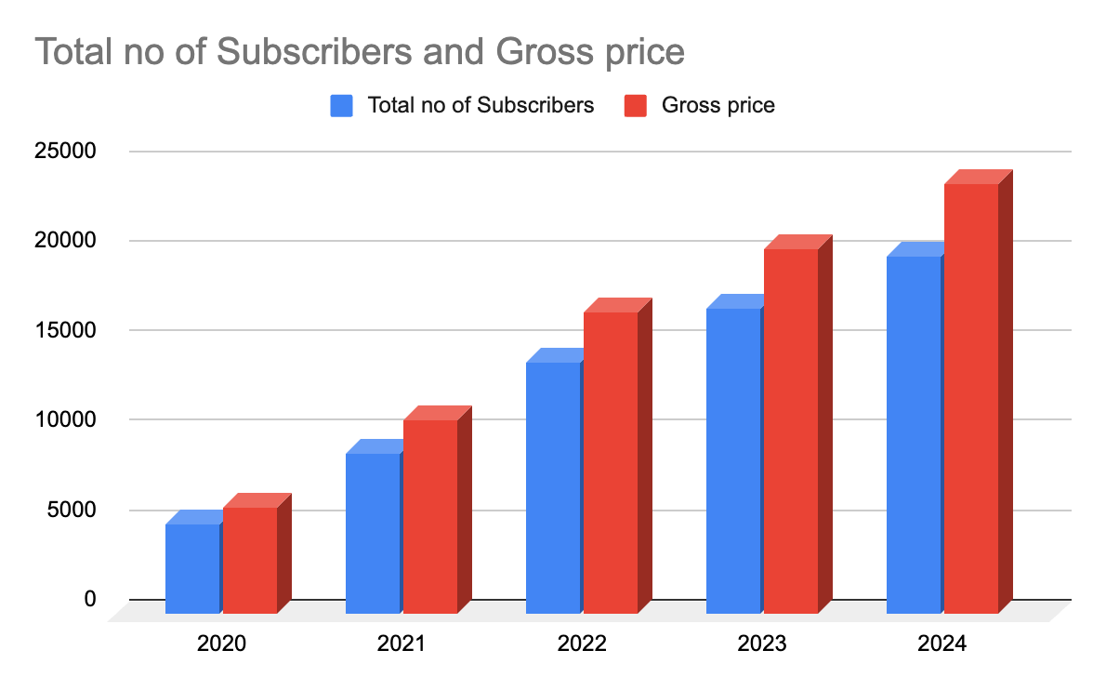
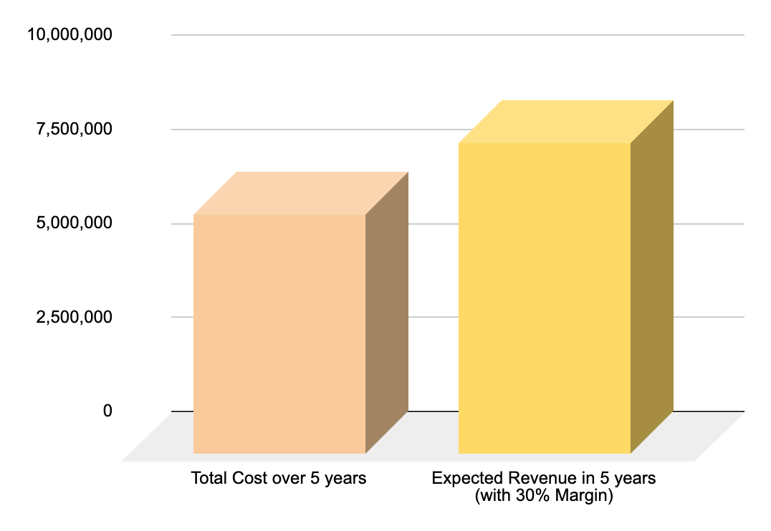
SUMMARY
Below are our subscriber counts year by year along with revenue and costs:

Slide 11
LIST OF SOURCES
https://www.databridgemarketresearch.com/reports/europe-telehealth-market
https://www.elinext.com/industries/healthcare/trends/telemedicine-market-in-germany-france-norway-research/
https://docs.google.com/spreadsheets/d/1elHB6Lx9YB8bEu2AGU1QTXuoGkmR-1AtlpLVJruOIGQ/edit#gid=1671107855
https://www.coolblue.nl/en/advice/how-much-energy-does-your-monitor-consume.html
https://remoteworkingwarriors.com/usb-keyboard-power-consumption/
https://www.energysage.com/electricity/house-watts/how-many-watts-does-a-wi-fi-router-use/
https://esource.bizenergyadvisor.com/article/small-and-midsize-offices
https://www.apple.com/support/products/mac/
https://pointerclicker.com/what-is-the-power-consumption-of-a-projector/

Slide 12

THANK YOU

